Slide 1

The History of Computers
By
Marc Kliebert

Slide 2
Important eras in the development of computers
Pre-History
Electronics
Mini
Micro

Slide 3
PRE-HISTORY ERA
4th century B.C. to 1930s
The abacus is believed to have been invented in 4th century B.C.
The Antikythera mechanism, a device used for registering and predicting the motion of the stars and planets, is dated to 1st century B.C.
Arabic numerals were introduced in Europe in the 8th and 9th century A.D. and was used until the 17th century.

Slide 4
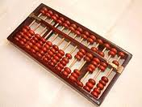
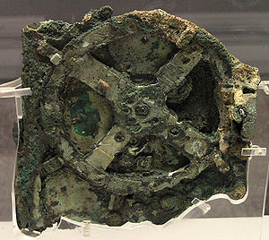
Pictures
Abacus Antikythera mechanism fragment

Slide 5
Pre-history era
John Napier of Scotland invented logs in 1614 to allow multiplication and division to be converted to addition and subtraction.
Wilhelm Schickard built a mechanical calculator in 1623 with a 6-digit capacity. The machine did work but it never made it beyond the prototype stage

Slide 6
Pre-history era
Leonardo Da Vinci is now given credit for building the first mechanical calculator around 1500. Evidence of Da Vinci’s machine was not found until papers were discovered in 1967.
Blaise Pascal builds a mechanical calculator in 1642 with an 8-digit capacity.

Slide 7
Pre-history era
Charles Babbage designs a “Difference Engine” in 1823 with a massive calculator designed to print astronomical tables. The British government cancelled the project in 1842
Augusta Ada Byron worked with Babbage and created a program for the Analytical Engine. Ada is now credited as being the 1st computer programmer.

Slide 8
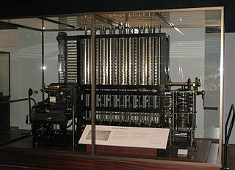
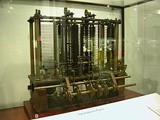
Pictures
Difference Engine Analytical Engine

Slide 9
Pre-history era
Samuel Morse invents the Electric Telegraph in 1837.
George Boole invents Boolean Algebra in the late 1840s. Boolean Algebra was destined to remain largely unknown and unused for the better part of a century, until a young student called Claude E. Shannon recognized its relevance to electronics design.

Slide 10
Pre-history era
In 1857, only twenty years after the invention of the telegraph, Sir Charles Wheatstone introduced the first application of paper tapes as a way to prepare, store, and transmit data.

Slide 11
Pre-history era
The first practical typewriting machine was conceived by three American inventors and friends, Christopher Latham Sholes, Carlos Glidden, and Samual W. Soule who spent their evenings tinkering together.
The friends sold their design to Remington and Sons. This resulted in the release of the first commercial typewriter in 1874.

Slide 12
The electronics era
1900-1964
In 1926, Dr. Julius Edgar Lilienfield from New York filed for a patent on a transistor.
Konrad Zuse, a German engineer, completes the 1st general purpose programmable calculator in 1941.
Colossus, a British computer used for code-breaking German codes, is operational by the end of 1943.

Slide 13
Electronic era
ENIAC (Electronic Numerical Integrator Analyzer and Computer) is developed by Ballistics Research Lab in Maryland and built by the University of Pennsylvania and completed in 1945.
Electro-mechanical computers ran on relays and vacuum tubes while some ran purely on mechanical internals with electric motors.
The Manchester Small-Scale Experimental Machine used random access memory (RAM).

Slide 14
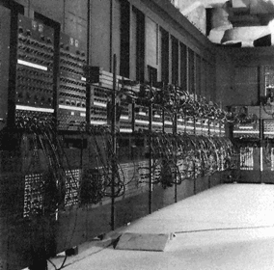
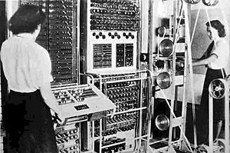
Pictures
The Colossus ENIAC

Slide 15
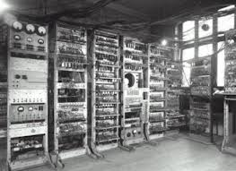
Pictures
The Manchester Small-Scale Experimental Machine

Slide 16
Electronic era
UNIVAC (Universal Automatic Computer) is developed in 1951 and can store 12,000 digits in random access mercury-delay lines
EDVAC (Electronic Discrete Variable Computer) is completed for the Ordinance Department in 1952.
IBM comes out with the 305 RAMAC in 1956.

Slide 17
Electronic era
Texas Instruments and Fairchild Semiconductor both announce the integrated circuit in 1959.
The IBM 360 is introduced in April of 1964 and quickly becomes the standard mainframe computer. It has pulled in over $100 billion in revenue for IBM.

Slide 18
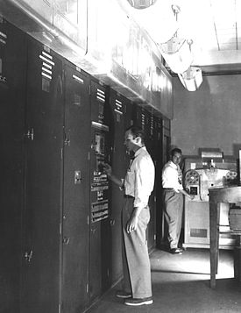
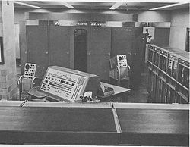
Pictures
UNIVAC II EDVAC

Slide 19
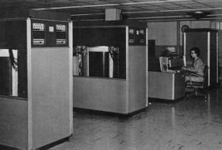
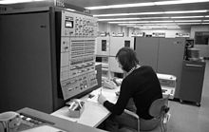
Pictures
IBM 305 RAMAC IBM 360

Slide 20
Mini era
1959 -1970
The Mini Era began with the development of the integrated circuit in 1959 by Texas Instruments and Fairchild Semiconductor.
The microchip is introduced in the 1960’s
Ivan Sutherland demonstrates a program called Sketchpad on a TX-2 mainframe at MIT’s Lincoln Labs in 1962.

Slide 21
Mini era
By 1965, an integrated circuit that cost $1,000 in 1959 now costs less than $10.
Doug Engelbart demonstrates a word processor in 1968.
Also in 1968, Gordon Moore and Robert Noyce founded a company called Intel.
Xerox creates its Palo Alto Research Center (Xerox PARC) in 1969.

Slide 22
Mini era
Fairchild Semiconductor introduces a 256-bit RAM chip in 1970.
In late 1970 Intel introduces a 1KB RAM chip and the 4004, a 4-bit microprocessor. Two years later comes the 8008, an 8-bit processor.

Slide 23
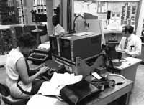
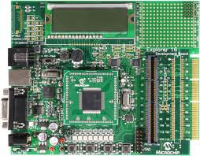
Pictures
Microchip The TX-2 at MIT

Slide 24
Micro era
1971 - 1989
Bill Gates and Paul Allen form Traf-O-Data in 1971 to sell their computer traffic-analysis systems.
Gary Kildall writes PL/M, the first high-level programming language for the Intel Microprocessor
Steve Jobs and Steve Wozniak are building and selling “blue boxes” in Southern California in 1971

Slide 25
Micro era
The floppy disk became available for use in 1971.
Intel introduces the 8008, the first 8-bit microprocessor in April of 1972.
Jonathan A. Titus designs the Mark-8 and is featured in the July 1974 Radio Electronics.
In 1975 Popular Electronics features the MITS Altair 8800. This was called the first personal computer.

Slide 26
Micro era
Paul Allen and Bill Gates develop BASIC for the Altair 8800. Microsoft is born!
Apple is selling its Apple II for $1,195, including 16K of RAM but no monitor by 1977.
Software Arts develops the first spreadsheet program called VisiCalc. by the spring of 1979, 500 copies a month are shipped in will increase to 12,000 per month by 1981.

Slide 27
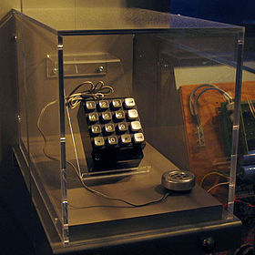
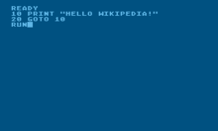
Pictures
The blue box built by Steve Wozniak. BASIC

Slide 28
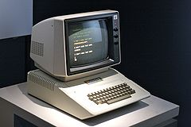
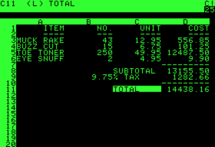
Pictures
The Apple II VisiCalc

Slide 29
Micro era
By 1980 Apple has captured 50% of the personal computer market.
In 1980 Microsoft is approached by IBM to develop BASIC for its personal computer project. The IBM PC is released in August, 1981.
The Apple Macintosh, featuring a simple graphical interface using the 8-MHz, 32-bit Motorola 68000 CPU debuts in 1984.

Slide 30
Work cited
http://sixrevisions.com/resources/the-history-of-computers-in-a-nutshell/
http://classicgames.about.com/od/history/p/Pong-The-First-Video-Game-Megahit.htm
Galas, Judith C. Computers and the Internet. San Diego, CA: Greenhaven, 2001. Print

Slide 31
Work cited
http://inventors.about.com/od/computersandinternet/a/Ibm-Pc.htm
http://www.pbs.org/nerds/timeline/
http://personalpages.manchester.ac.uk/staff/m.dodge/cybergeography//atlas/historical.html
http://www.computerhistory.org/
Timeline of Computer History. eLibrary. Web. 28 Oct. 2012.
http://www.crystalgraphics.com/powerpoint/Templates.Search.Details.asp?product=Computers_0803

